Slide 1

BERMUDA MENTAL HEALTH FOUNDATION
Annie Richardson - Director

Slide 2
Bermuda Mental Health Foundation – who are we?
THE FOUNDATION
OUR MISSION
Founded in 1994
​Non-profit all-volunteer organization
Our evolution
  From... Residential Care facilities management
  To… Mental Health Advocacy and Education
​
Raise awareness and combat stigma around mental illness, educating and campaigning to improve mental health services
​Provide resources that will enhance the care and support for individuals and their families​
We aim to change the conversation around Mental Health with a focus on facts, education and empathy

Slide 3

THE “WHY”?

Slide 4
Did you know?
1 in 4 people will experience a mental health issue of some kind this year
During the pandemic, stress, depression and anxiety accounted for 50% of all work-related ill health
84% of employees do not feel able to discuss a mental health issue with their manager
92% believe that admitting to a mental health condition would damage their career
Depression and anxiety disorders can result in a loss of up to $1 trillion in global productivity each year… and 12 billion working days every year!
Good workplace mental health practices can raise morale, retention, innovation and profits
By normalizing Mental Health in the workplace, we affect the community, one employer at a time

Slide 5
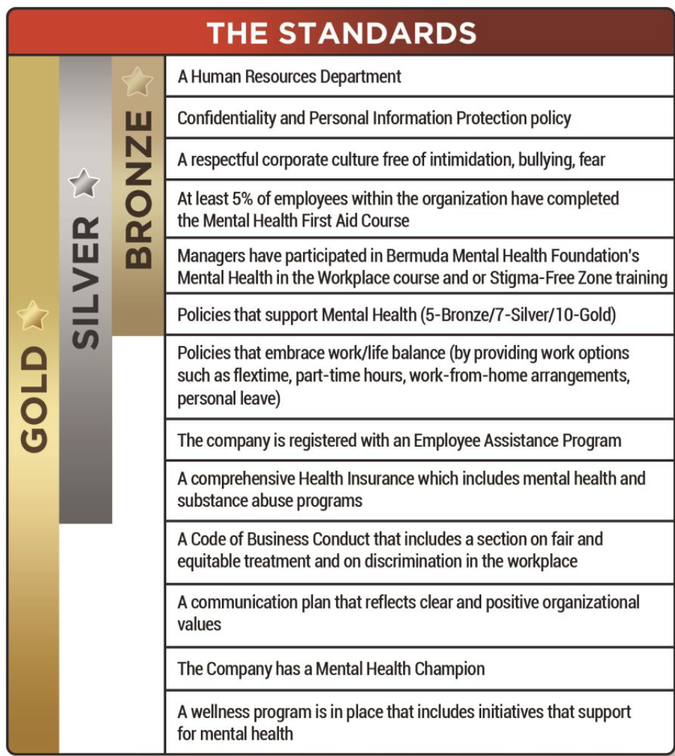
Mindful Employer Certificate - 13 standards | 3 levels

Slide 6

In partnership with CG Insurance and the Mindful Society Global Institute
14th standard: 10% managers must complete the Mindful Leader Program
a six-week leadership program covering topics like mindfulness, stress management, focus at work, communication and optimal work-life habits
with Michael Apollo MHSc, RP; leader in workplace mindfulness and executive development, and founder/CEO - Mindful Society Global Institute
NEW!! Mindful Leader Program – The 14th standard | Platinum Level

Slide 7
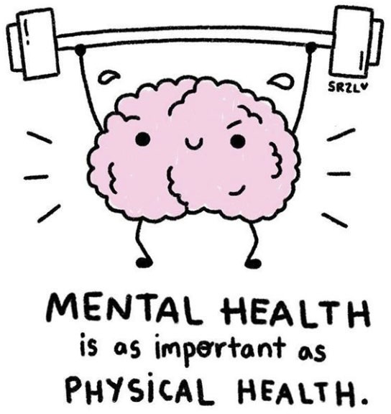
Mindful Employer Certification - why not?
As an employer you can:
The pandemic has triggered a 25% increase in anxiety and depression worldwide
​
Build a culture of prevention around mental health at work
Build knowledge and skills for open conversations around mental health
Reshape the work environment to stop stigma and social exclusion
Mitigate the impact poor workplace mental health can have on the business and the culture
Attract and retain employees who value a supportive workplace
Normalizing Mental Health = a healthier and more empathetic workforce AND a Better Bermuda

Slide 8
Mindful Employer Certification - the process
ENGAGE
EDUCATE
EMBED
Take Stock
Raise awareness
Communicate commitment
Culture check/Interviews
​Community Partners & resources
Stigma in the workplace training
All-staff lunch and learns
Manager training (80%)
Mental Health First Aid training (5%​)
Mindful Leader Program (10%)
Implement actions/approach to:
Minimize stress
Support employees’ wellness
Zero tolerance approach
Nominate Mental Health Champion​
Recertify every two years
One employer at a time….
Notes:
Engage with employees
Interview Leadership
Survey Employees
Review policies
Announce commitment
Educate
Help employees understand their role,
building confidence
Reducing stigma
Community Partners – monthly meet-ups/ lunch and learns /team building activities
Embed
Implement solid action plan and approach to prevent bullying/harassment
And to foster a supportive
EDUCATE – To achieve any levels - training component is required

Slide 9


Slide 10
THANK YOU
Annie Richardson
arichardson@archgroup.com
www.bmhf.com

