Slide 1
Digital Age and the Impacts on Mental Health:
A dive into Social Media and Technology, Significant Implications or not
Ms. Chardonaé Rawlins, MSC, CAIP

Slide 2
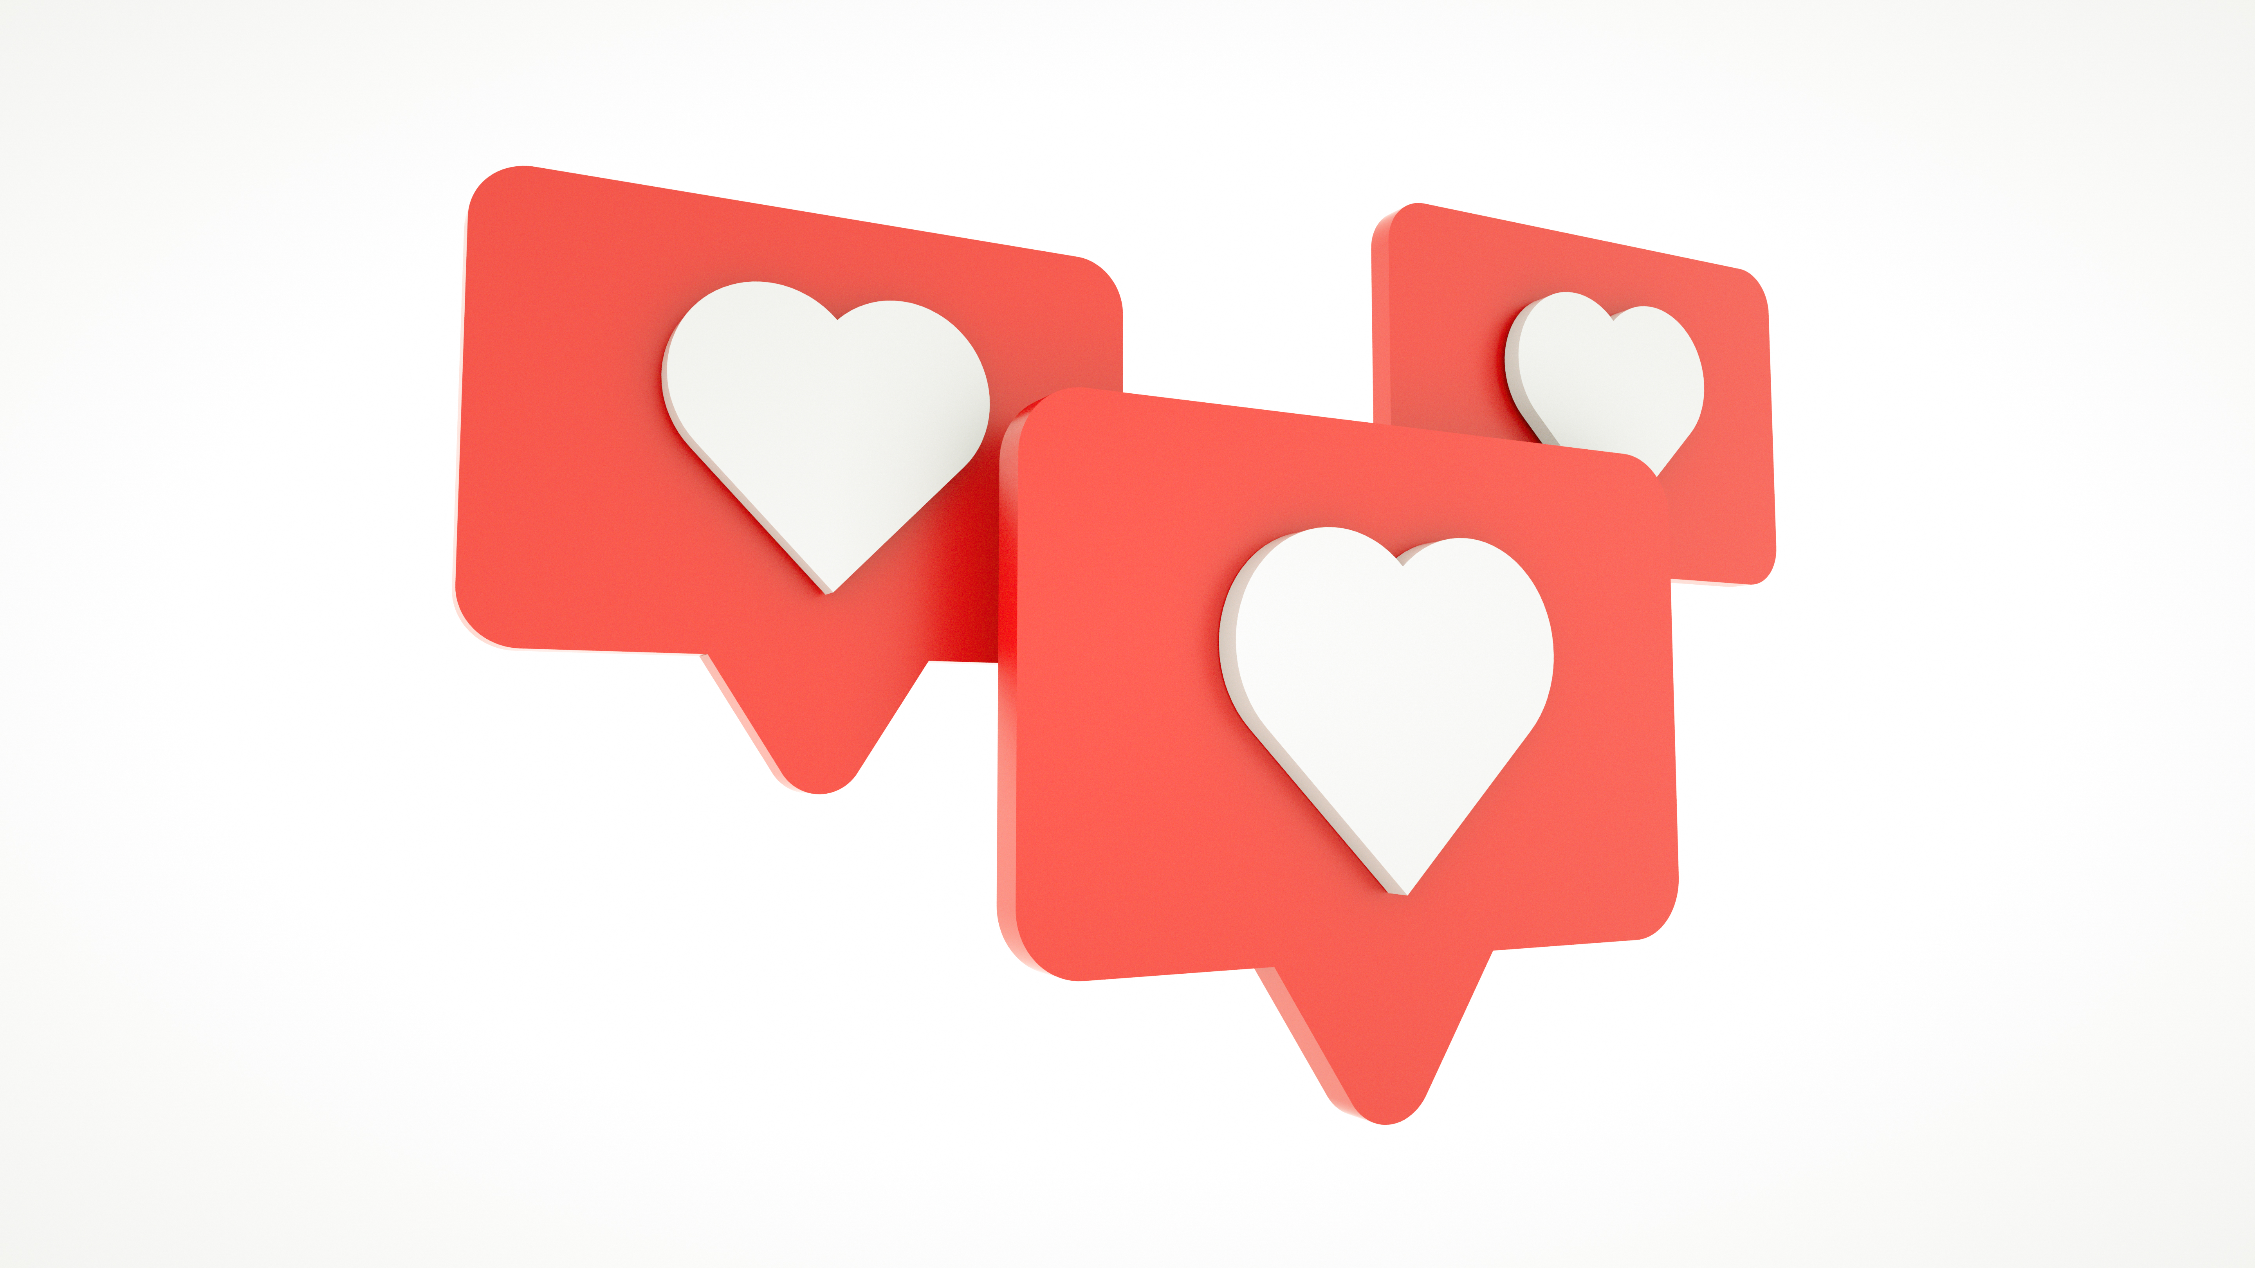
Agenda
Why do we use Social Media?
Influence of the Digital Age
Mental Health Trends
Brain development & Screen Exposure
Emotional Centres of the Brain
Impact on Critical Thinking
Gender Implications & Social Media
Assessing Risk and Protective Factors
Screen Time Balance

Slide 3
Why do we use social media & technology?
Connection / sense of belonging
Self-esteem
Expression
Popularity
Entertainment
To be in the know
Notes:
Ask the audience

Slide 4
The Power of Digital Influence
Technology has changed the way we view the world
Notes:
Raise your hand if you agree with this statement

Slide 5
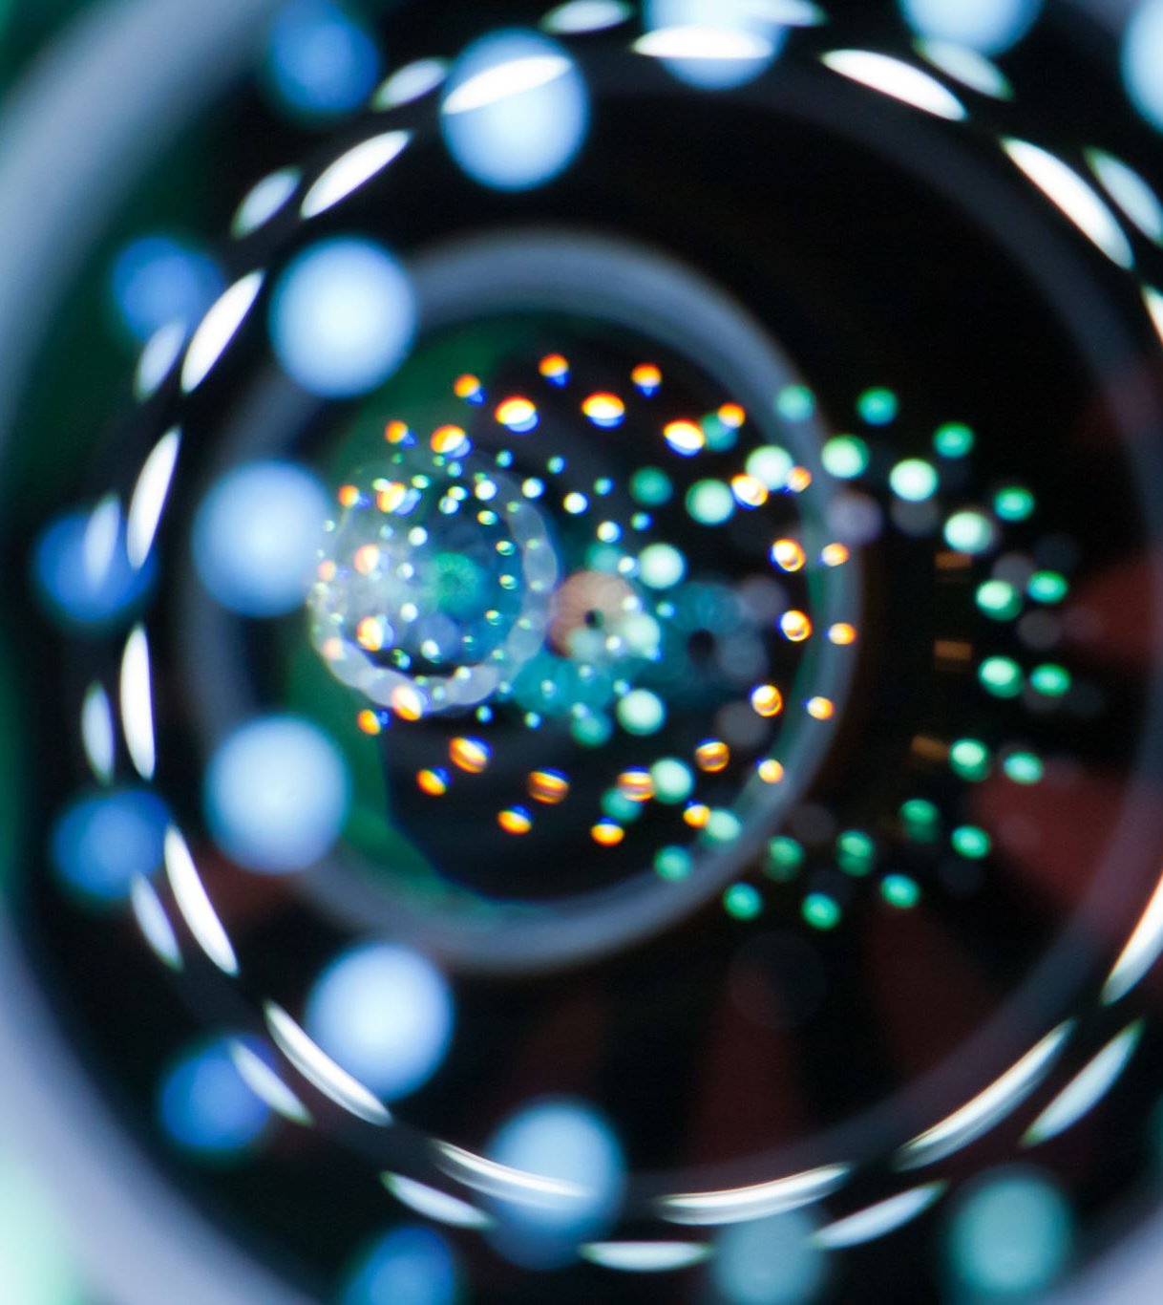
3 R’s of Digital Influence
Reach
Relevance
Resonance
Notes:
Digital influence is a triangle which encompasses 3 core parts to garner desired responses and they are the following
Reach: the amount of people the website can reach
Relevance: attracting people to your target group
Resonance: the ability to create an audience based on similarities and shared interest

Slide 6
Elements of Digital Influence
Creating an effect
Change opinions
Influence behaviours
Impact existing ideologies
Influence actions
Persuade decision making
Notes:
There are certain key elements that are considered the ‘holy grail’ of digital influence being achieved.
Please keep these in mind as we discuss mental health trends as they coincide with the information presented

Slide 7
Activity Time
3min
Notes:
Discuss with your neighbour any real life experiences you have with digital influence? And from what social media sources
3 volunteers can share their answers.

Slide 8
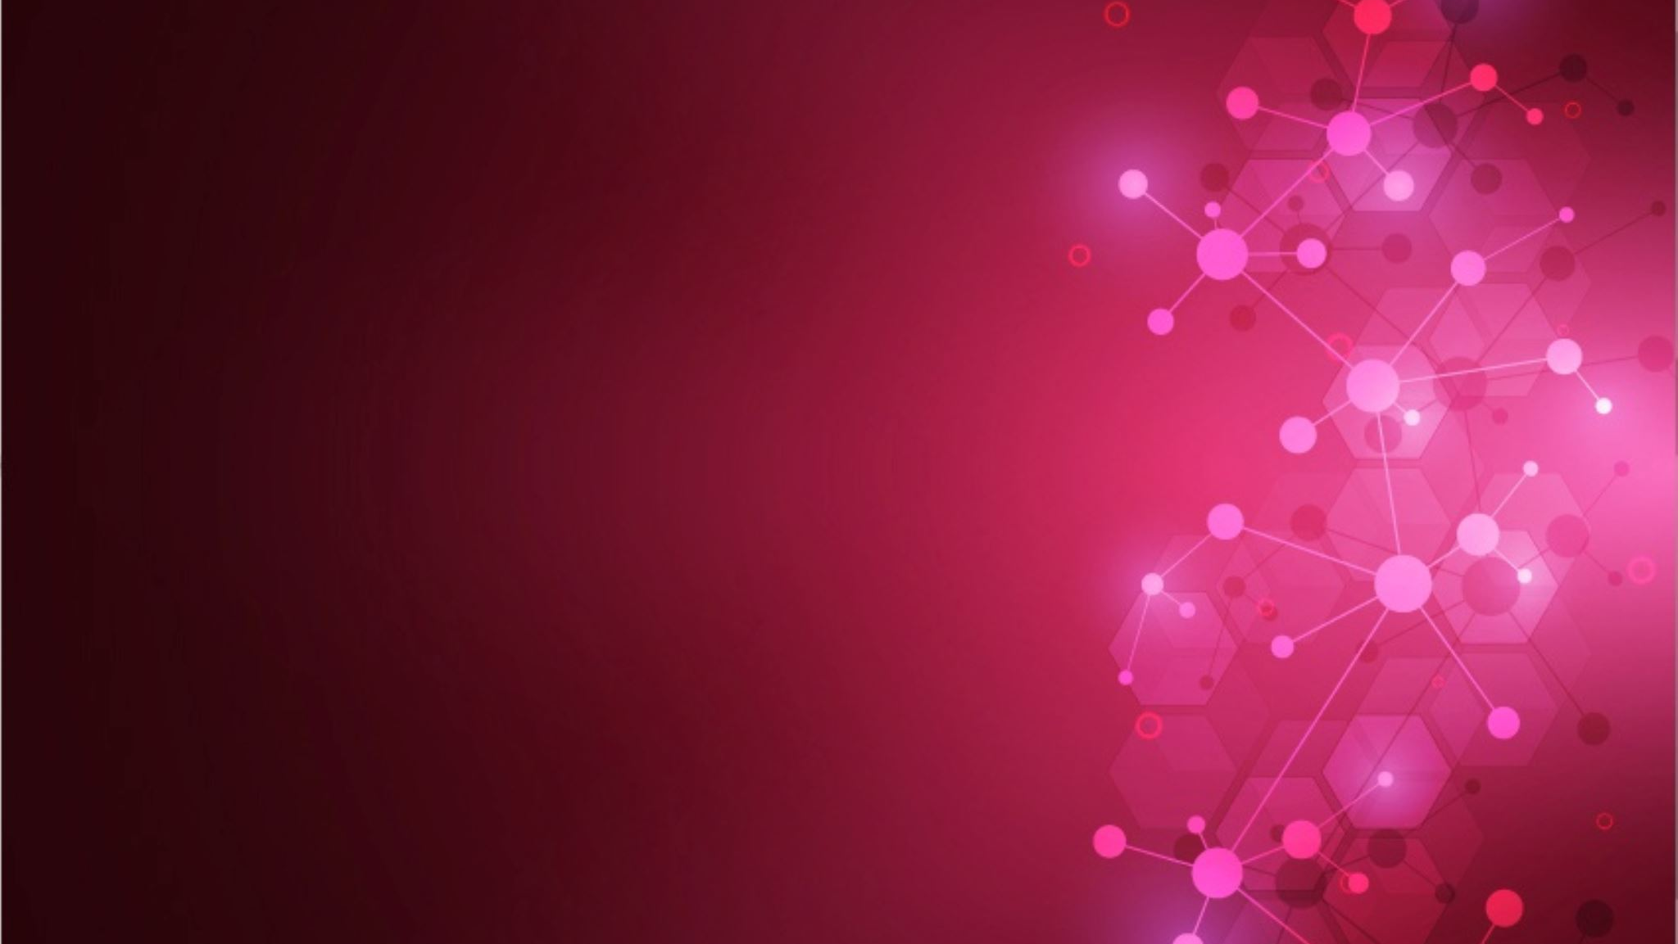
Mental Health Trends
Based on empirical literature
Notes:
All of the following information is based off of empirical literature, it includes studies on children, adolescents and adult populations to create an in-depth scope

Slide 9
Notes:
Here is a quick video to outline some of the mental health implications we will discuss further
Stop at 2:24 when she talks about online relationships aren’t the only ones we should have

Slide 10
Vulnerability
The earlier children start using social media and technology, the greater the impact on mental health
Children are impressionable
Instant gratification
Exposure to new and unfamiliar topics / behaviours
Notes:
Instant gratification is the emotional response of happiness or pleasure to the fulfillment of a goal or in this case a combination of the above with social needs such as affiliation, socializing, social approval or mutual recognition.
Instant gratification is associated with the activation of dopamine receptors. The persistent dopamine loop rewires the brain to expect instant rewards and results through likes, comments, streaming new content and receiving notifications.
Parental controls exist however, there are videos and characters that are inappropriate and target child viewers such as Huggy Wuggy & adult versions of popular children’s characters that are identical to lure in young viewers.
Such character renditions are exposing children to inappropriate language, anti-social, sexual and self-harming behaviours and cyberbullying

Slide 12
Brain Development and Early Exposure to Screens
Excessive screen time hinders attention spans
Lower cognitive abilities
Speech and language delays
Impacts problem solving skills
Notes:
Research indicates that:
Early screen time exposure is associated with lower cognitive abilities and academic performance
Excessive screen time and media multitasking can negatively affect executive functioning, sensorimotor development, and academic outcomes.

Slide 13
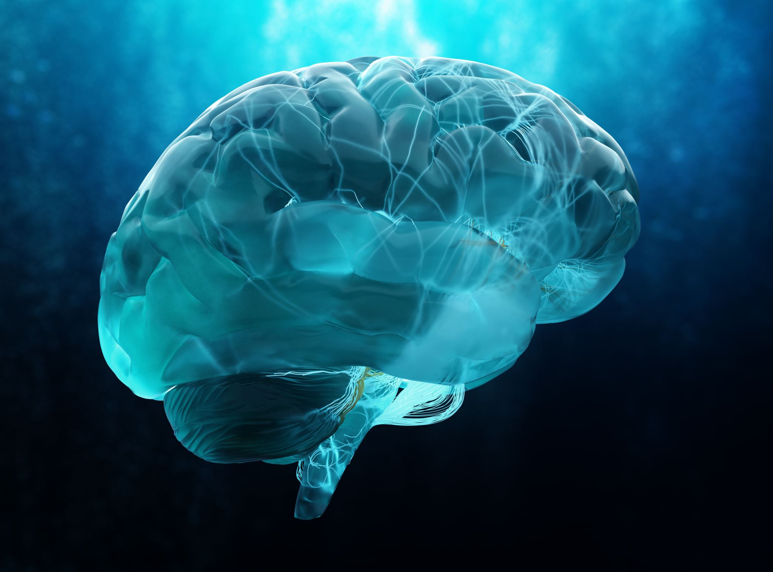
Emotional Centres of the Brain & Social Media Usage
Ventral Striatum activation
The adolescent brain
Instant gratification is linked to addiction
Dopamine Loop / Release
Oxytocin Release
Over stimulation of the amygdala correlates with anxiety behaviours
Notes:
Ventral striatum activation: Starting around age 10, children’s brains undergo a fundamental shift that spurs them to seek social rewards, including attention , admiration, compliments and approval from their peers.
Adolescents brains are rapidly changing which makes them more susceptible to instant gratification and social rewards because at this age they are seeking social acceptance from peers
Dopamine is the feel good chemical, is activated when using SM due to the likes, shares and comments. Heightening the chances of addiction for some users.
With the amygdala SM comparison can cause the viewer to enter a state of emotional anxiety. As users are anxiously awaiting the instant gratification of followers.
Give an example of not receiving the amount of likes anticipated from a 'great picture' which can be very detrimental o sense of self and your self esteem as we live in a society which is based off of likes and adoration
The above mentioned can alter our individual belief systems
Core beliefs include the thoughts and assumptions we hold about ourselves, others, and the world around us. They are deep-seated beliefs which often go unrecognised and yet they constantly affect our lives. For example:

Slide 14
Question: How do you think social media and depression are connected?

Slide 15
Depression
Causation vs. Correlation?
Various depressive symptoms
Decreased self-esteem
Body Image
FOMO
Self-harming behaviours
Interpersonal connections
Bullying
Social comparison
Notes:
There is a great debate on whether SM correlates with depression or is a causation. If you don’t know the difference between the two, causation is when one thing leads to another while correlation shows the relationship
Heightened depressive symptoms are highlighted in numerous empirical literature since the rise of social media usage in about 2012
There are various depressive symptoms linked to social media usage and I have listed a few major ones that are consistent amongst literature for both adolescents and adults.
Decreased self-esteem – linked to body image, feeling less than due to social comparison
FOMO – the constant need to check and be in the know of what’s going on in the lives of others
An increase of self-harming behaviours from SM use due to both increased depressive symptoms and being exposed to the behaviours on SM
SM friends have replaced genuine in person connections which are essential for the wellbeing of humans. Society is so much apart of socialisation

Slide 16
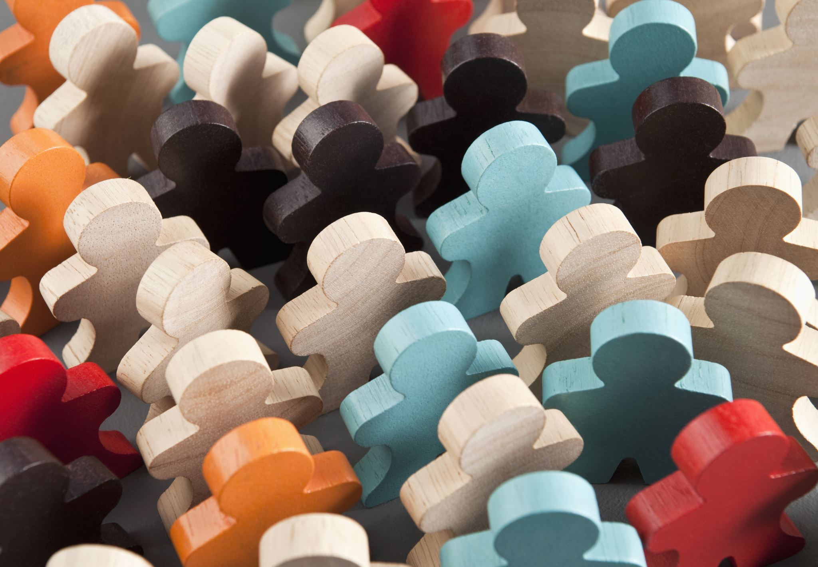
Social Comparison Theory (Festinger 1954)
Primitive drive to compare themselves to others
Evaluating abilities and opinions based on others
Sense of self derives from comparing to others
Self-esteem is based on others perception
Comparing to others who are ‘worse’ than to boost self-esteem
Unrealistic expectations
Notes:
I would like to highlight this theory as it Is exemplified when using social media
Festinger’s principles of social comparison are still used today and are applied regarding social media use

Slide 17
Activity Time
5min

Slide 18
What do these images evoke?
Notes:
`thinking back to social comparison theory, When you view these 2, what comes to mind?
I specifically chose 2 different body types and women who have 2 very different brands but with large followings
A reality tv star worth 1.7 billion at age 43
A singer songwriter worth 40mil at age 35
Ties into body image and dissatisfaction we discussed earlier. The Kardashian’s are known for their ‘perfect’ bodies as they embody what society perceives to be ideal
The 3 R’s because they are a brand with a following
People want what they have whether it be the clothes, the money, the makeup, the hair
People think that they can receive the instant gratification of being an influencer like these two are
Influencer culture is very large in America, Canada and the UK

Slide 20
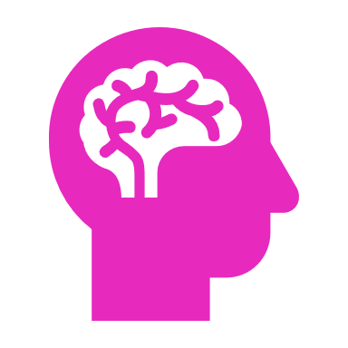
Anxiety
Social comparison
Anticipating responses / engagement
Sleep disturbance
Increase in social anxiety symptoms
Mitigating anxiety symptoms
Notes:
The lack of positive reinforcement through likes, comments and follows can cause you to experience anxiety
Fear of being judged by others may increase in a setting where it’s easy to compare yourself, others may feel validated or invalidated by engagement
Users may feel as though they are not living up to the ideals others share on their feed which can increase symptoms of social anxiety causing one to compare themselves
Anxieties may cultivate when having to meet or interact with people in real life, if users have put a lot of effort into portraying only certain aspects of their lives online
Fear being scrutinized by others due to using heavy filters to change or enhance appearance
Research suggest that users who use SM to view what others post, can lead to social anxiety symptoms than those who use it to interact with other users
Contrastingly, some users with anxiety have their symptoms alleviated through social media due to feeling heard, seen, understood and realizing that they are not alone

Slide 21
Question: Raise your hand if you believe that there are gender implications associated with social media use

Slide 22
Gender Implications
Internalising
Toxic masculinity
LGBTQ+ Phobias
Body dissatisfaction
Notes:
Internalising behaviours such as social withdrawal and eating disorders are more prevalent in females vs. males
By show of hands, how many people know what an internalising behaviour is - depending on amount of hands then explain
Internalising behaviours are: negative behaviours that are focused inward based on an emotional state.
Toxic masculinity A set of attitudes and expectations society has placed on men which can be deemed problematic and unrealistic, leading some men to feel entitled and behave as if they are superior
Toxic masculinity can also be stressful and anxiety provoking for men who feel that they do not fit within societies expectations
Social media allows for freedom of speech which means that opinions on LGBTQ+ are at the forefront from the various movements surrounding their community. Some of which have been detrimental to the MH of LGBTQ+ persons due to the phobia and hate spewed towards them.
Again, body dissatisfaction is more prominent in females than males because of the way the social media influencers are presenting themselves with unrealistic expectations. The rates of cosmetic surgery have sky rocketed as people would like to change their features to enhance their beauty to match societies standards.

Slide 23
Looking at the Statistics
75% of women ages 16-24 experience low moods
01
78% of women aged 16-24 feel lonely
02
60% of women aged 16-24 experience feelings of jealousy
03
25% of men cast judgement based on social media content they have viewed
04
Women are twice as likely to doubt their experience and abilities than men
05
Notes:
With understanding gender implications a bit more as it relates to social media usage. Here are some statistics on gender use and social media drawn from the UK social media study in 2022

Slide 24
Statistics Cont’d
1 and 3 men experience negative feelings while using social media
29% of men compare themselves to their followers
Anxiety symptoms are doubled in women than men
Women are twice as likely to experience FOMO than men
Notes:
Based upon the UK’s study it is apparent that females experience more adverse side effects from social media usage than males
I thoroughly enoy these statistics because they include the adverse effects men endure when using social media. This is not often highlighted in literature and I think men's mental health is sometimes overshadowed by the toxic masculinity concepts of men having to be strong and lacking emotions. Especially black men in particular
Where these statistics show that social comparison theory impacts males as well

Slide 25
Critical Thinking
Implications based on empirical literature

Slide 26
Critical Thinking (CT) Impairments
Causation or correlation?
Screen time and impaired CT
Increased stress
Decreased self-esteem
Cognitive decline
Notes:
Critical thinking is the ability to analyse information and form judgement while being aware of your own biases and assumptions while digesting info
Research indicates that adolescents and adults who have excessive screentime (exceeding 5hrs a day) have impaired critical thinking which impacts performance
Persons who have impaired CT often present themselves with depressive symptoms due to the increase of stress, and low self esteem. It is plausible that CT impairment can cause the onset of depression

Slide 27
Risk & Protective Factors
A general overview

Slide 28
Brief Comparison
Risk Factors
Protective Factors
Internal locus of control
External locus of control
Addiction
Emotional instability
Cognitive and behavioural delays
Exposure to harmful content
Bullying
Support
Education
Empowering
Connection
Notes:
Internal and external locus of control are associated with needing validation from others, vs your own. While comparison to others and frequent need to check devices and be in the know are associated with external locus of control
Exposure to harmful content can be influential in terms of self harming mechanisms to cope life's adversities.
Protective factors:
Users may feel supported by being able to vent to others online who may be going through similar circumstances or adversities
Psychoeducation is provided on social media platforms which offers coping mechanisms which users with mental health challenges find beneficial
Education in other forms such as news and exploring hobbies online
Social media allows people to have a voice and opinions be heard / valued by other users
Social media provides easy access and communication with friends and loved ones around the world and interpersonal relationships are important for humans
If you look at the two lists, risk factors is a bit longer. However, the protective factors are quite powerful despite being a shorter list.

Slide 29
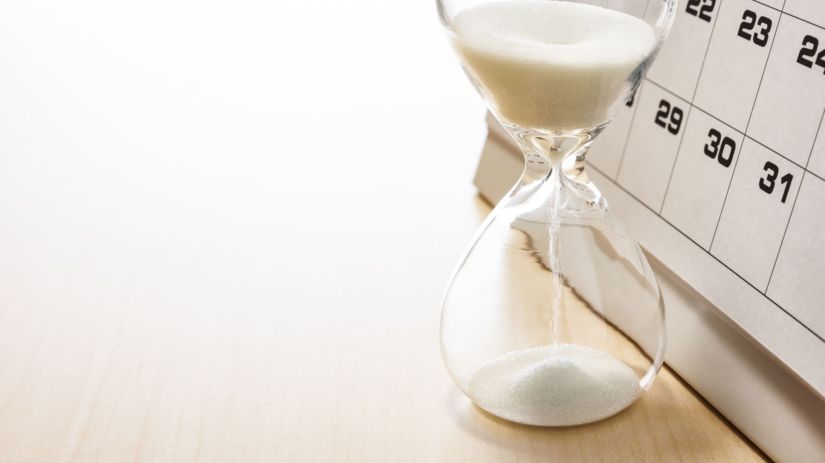
Screen Time Balance
The importance

Slide 30
What is Screen Time?
Passive screen time:
monitoring and scrolling through social media
Active screen time:
Intentional use of technology such as writing posts, taking pictures, reading the news etc.
Notes:
Essentially the way in which we use our devices. Whether it be for productivity or leisure.
When you look at your screen time use for yesterday, how many hours did you spend on your device? What apps took up most of your time? When looking at your own, imagine what children are doing when on their ipad or phones daily especially while school is out.
For me, yesterday I spent 8 hours on the phone and 6 of the 8 were social use and my most used app is whatsapp and tiktok
Do a few of you wish to share?

Slide 31
Activity Time
3min
Notes:
When you look at your screen time use for yesterday, how many hours did you spend on your device? What apps took up most of your time? When looking at your own, imagine what children are doing when on their ipad or phones daily especially while school is out.
For me, yesterday I spent 8 hours on the phone and 6 of the 8 were social use and my most used app is whatsapp and tiktok
Do a few of you wish to share?

Slide 32
Excessive Screen Time can cause the Following
Hindrance to the production of melatonin
The brain remains alert and activated
Impact on cognitive performance
Obesity
Notes:
The digital world is ever evolving and research indicates that the more time spent on screens, the more at risk individuals are at developing mental health symptoms or being at risk of viewing harmful content in addition to altering the way our brain works.
Blue light from devices inhibits and delays our bodies production of melatonin, which can delay sleep Being on screens causes our brains to stay more alert and activated therefore not ready for sleep Lack of sleep can impact persons from optimum performance Research demonstrates that the more we are on screens the more of a sedentary lifestyle we develop which can lead to obesity

Slide 33
Ways to create balance
Mindfulness
Self-care
Participate in group activities that do not involve screens
Encourage hobbies that do not involve a screen
Emphasize connection and creativity while using devices
Reinforce time limits
Notes:
With all the information presented here are ways to incorporate balance to minimise the mental health risks associated with technology

Slide 34
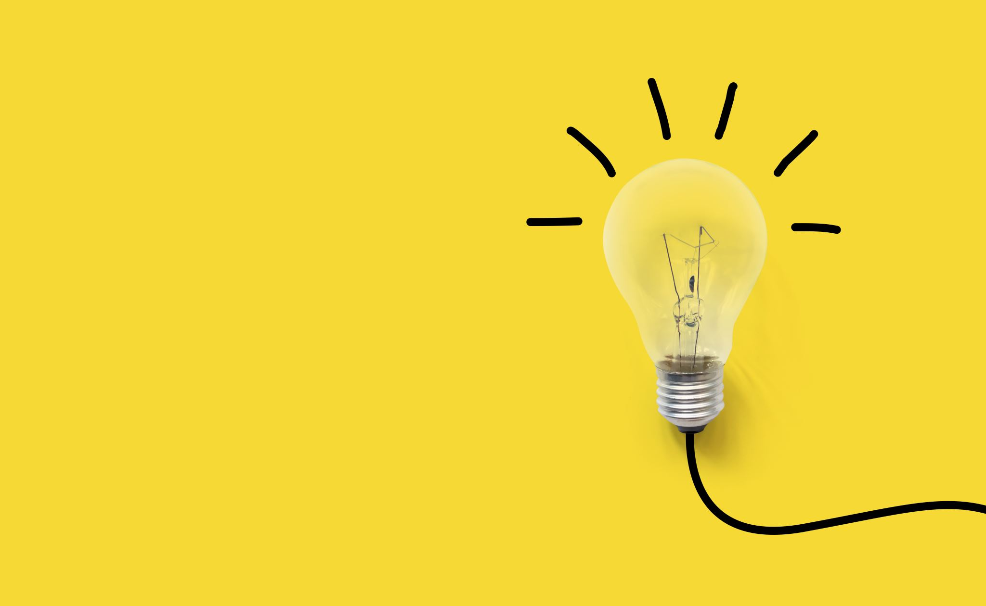
Food for thought…
Notes:
There is no research on Bermudians use of social media / technology and the implications it leads to
While there is evidence through revenge porn and bullying cases and the impacts of such, it would be interesting to see BDA’s results of the above mentioned

Slide 35
Questions?

Slide 36
Contact Information
Email: info@simplybloombda.com
Tel: 441-519-8024
Website: www.simplybloombda.com

